Slide 1
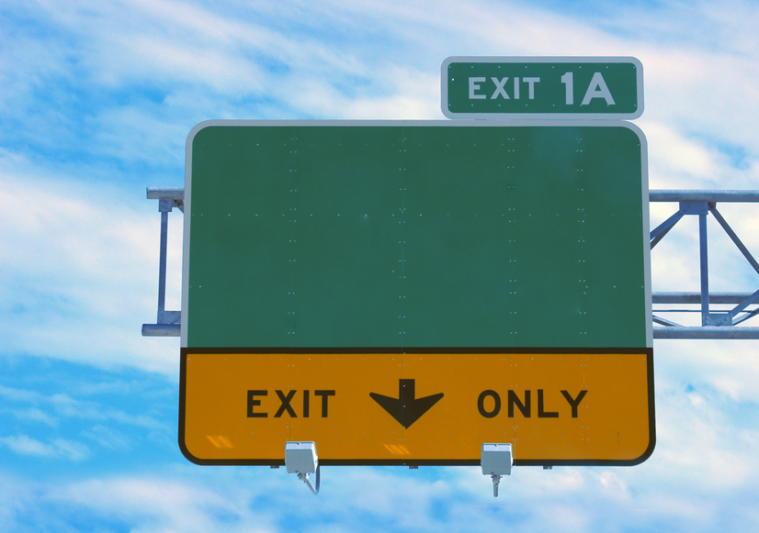
Greater Olney Civic Association
Olney
Transportation Committee
Commuter Survey Results – November 2014
Daniel Rubenstein
GOCA Transportation Committee
November 11, 2014

Slide 2
Survey Goals
Obtain actionable data regarding Greater Olney commuter patterns
Identify key trends and common responses to commuting methods and routes
Determine short-term and long-term opportunities to reduce congestion through roadway improvements and public transit alternatives

Slide 3
Survey Design
10 question survey, covering four topics:
Survey Population – determine who is responding to the survey by location
Commuters vs. Non-commuters –separate telework/retiree populations
Commuting Methods – determine percent of drivers/carpool versus transit
Transit Destinations – determine destination and transit time for each commuter

Slide 4
Survey Limitations
Survey population is necessarily self-selecting. Limited to tech-savvy residents (who saw the electronic announcement and followed a link to complete the survey).
Also limited to residents who have an opinion (positive or negative) regarding their commute.
465 responses represent only a fraction of the community.

Slide 5
Additional Notes
Survey began on October 15, 2014 and closed on November 4, 2014.
Interim results (based on 300 responses) were discussed at the GOCA Transportation Committee meeting on October 22. Decision was made to collect additional responses.
Final results (based on 465 responses) did not substantially affect the trends identified based on the interim results.

Slide 6
Part I: Survey Population
Survey asked user to select zip code from the following options:
20832 (Olney)
20833 (Brookeville)
20853 (Rockville)
Other (user enters zip code)
Goal: confirm that survey respondents reside in Olney or neighboring areas

Slide 7
Part I: Survey Population
Question: Where do you live?
76.4% from Olney (20832)
15.6% from Brookeville (20833)
3.2% from Rockville (20853)
1.9% from Sandy Spring/Ashton (20860 and 20861)
Result: The three zip codes captured 95% of responses. An additional 2% came from Sandy Spring and Ashton. The balance came from nearby areas outside of GOCA’s boundaries.

Slide 8
Part II: Commuters v Non-Commuters
It was important to note that some residents do not commute to work (e.g., teleworkers, retirees, stay-at-home parents/caregivers, unemployed)
While these individuals still contribute to traffic volumes, their commuting patterns are less predictable.
These individuals are more likely to avoid rush hours and common area bottlenecks

Slide 9
Part II: Commuters v Non-Commuters
Question: How often do Olney residents work outside the home (commute?)
61% work outside the home 5 days per week
12% work outside the home 4 days per week
11% work from home/telecommute or don’t work
Result: Demonstrates that survey results for other questions reflect the majority of respondents (73%). Non-commuters do not heavily skew the responses.

Slide 10
Part II: Commuters v Non-Commuters
Question: Does your job permit telecommuting, and if so, do you telecommute?
62% are not permitted to telecommute, or aren’t sure if they can do so
20% are permitted to telecommute 1 day per week
Of this group, 61% actually do so. 39% do not.
Result: Demonstrates that the majority of commuters must commute every day. For those that can telecommute one day per week (commonly Friday), not all actually do so. Explains why traffic volumes are lighter on Fridays, but not “excellent.”

Slide 11
Part III: Commuting Methods
Goal: Part III is the heart of the Transportation Survey. It seeks to determine how individuals are getting to work, and where they are going.
The value in these responses comes from the ability to cross-reference the following:
Method of commute: car, carpool, bus, rail
Destination: Montgomery County, D.C., others
Time: Amount of time to reach destination

Slide 12
Part III: Commuting Methods
Question: How do Olney residents get to work?
83.9% drive to work
8.9% drive to Glenmont Metro Station
1.7% carpool to work
2.4% take the bus to work
1.4% drive to Shady Grove Metro Station
Result: Residents overwhelmingly drive to work, despite the fact that Olney is located within close proximity to multiple forms of public transportation (Metrobus, Metrorail, Ride On and ICC Commuter Bus)

Slide 13
Part III: Commuting Methods
Question: For those that use public transit, where is their final destination?
82% to Washington, D.C.
7% to Silver Spring
7% to Northern Virginia
2% to Rockville
2% to Bethesda
Result: Commuters to Washington D.C. see value in using public transportation from Olney (either in cost savings or time savings – or both). Contributing factors likely include high parking costs in D.C. and heavy traffic

Slide 14
Part III: Commuting Methods
Question: Do you use the ICC to get to work?
78% say no
22% say yes. For those that take the ICC, destination:
17% to Rockville
13% to Washington, D.C.
10% to Northern Virginia
9% to Silver Spring
7% to Bethesda
Result: Most drivers do not see value in taking the ICC (either because the cost of the toll outweighs benefit of time savings, or no time savings exists)

Slide 15
Part IV: Destinations
Question: For those that work outside the home, where is their ultimate destination?
19.8% commute to Washington, D.C.
17.4% commute to Rockville
11.6% commute to Silver Spring
10.1% commute to Bethesda
7.5% commute to points local (GOCA boundaries)
4.8% commute to Germantown/Gaithersburg
4.8% commute to Columbia/BWI/Baltimore
Result: Almost all Olney residents commute to Washington, D.C. or to points within the County.

Slide 16
Part IV: Destinations
Question: For the top commuting destinations discussed in the previous slide, how are Olney residents getting there?
Washington, D.C.: 44% drive, 56% use public transit (almost exclusively metro rail)
Rockville: 98% drive; 2% use public transit
Silver Spring: 92% drive; 8% use public transit
Bethesda: 97% drive, 3% use public transit
Result: There is a notable split in commuting patterns between Washington, D.C. and Montgomery County destinations. Intra-county commuters do not see value in public transportation (likely reasons: no cost savings; no time savings; reduced travel flexibility).

Slide 17
Part IV: Destinations
Question: For Olney residents that specifically drive to work, where are they going?
20% drive to Rockville
13% drive to Silver Spring
12% drive to Bethesda
9% drive to Washington, D.C.
9% drive to Local
6% drive to Gaithersburg/Germantown
5% drive to Northern VA
Result: Drivers commute heavily toward points South and West, but few cross the D.C. border. The majority of commuters do not travel exclusively North-South (Georgia Ave.)

Slide 18
Part IV: Destinations
Question: How long does it take to get to work, and where is work?
10 minutes or less (8%) | Local
20 minutes (13%) | Local, Rockville, Silver Spring
30 minutes (26%) | Bethesda, Rockville, Silver Spring, G’town/G’burg
40 minutes (14%) | Bethesda, Silver Spring, Greenbelt
50 minutes (14%) | Bethesda, Washington, Northern VA
60 minutes or longer (21%) | Washington, Northern VA
Result: Commute times are evenly distributed, and vary as would be expected (furthest destinations take longest time). Top destinations (Rockville, Bethesda, Silver Spring) all take about 20-30 minutes. Since most commuters drive, public transportation would almost certainly add delay to the commute time, based on existing schedules/modes of transportation.

Slide 19
Part IV: Destinations
Question: How long does it take to get home from work, and where is work?
10 minutes or less (7%) | Local
20 minutes (12%) | Local, Rockville, Silver Spring
30 minutes (23%) | Bethesda, Rockville, Silver Spring, G’town/G’burg
40 minutes (16%) | Bethesda, Rockville, Silver Spring
50 minutes (11%) | Bethesda, Washington
60 minutes or longer (31%) | Washington, Bethesda, Northern VA
Result: Same as above. Commute times home are slightly longer than commute times to work, demonstrating less flexibility in evening departure times than morning arrival times.

Slide 20
Participant Comments
The survey contained an “open comments” box, intended to help the Transportation Committee identify other data points for consideration for the next survey that may not be captured in the limited discussion above.
151 out of 465 left comments
Majority of comments pertain to ICC or BRT
Comments split evenly between pro/anti-ICC
BRT comments overwhelmingly negative
Additional comments related to need for signal timing correction, more reliable public transportation, and additional bike infrastructure

Slide 21
Conclusions
The overwhelming majority of Olney residents drive to work (84%) – implies that current public transportation system is either inefficient, not cost effective, or doesn’t permit the needed degree of flexibility in one’s daily routine
Most drive to points within Montgomery County (70%) – top destinations are Rockville, Silver Spring, Bethesda or points local
The overwhelming majority of Olney residents that use public transit travel to DC (82%) – for this subset of commuters, there is a cost savings, time savings, or both, versus driving. Note, for example, that Metrorail runs every 3-5 minutes during peak periods (red line), ensuring that “a train will always be waiting at the station.”

Slide 22
Conclusions
Most Olney residents do not use the Intercounty Connector to get to work (22%) – likely a function of geography (Olney’s close proximity to top destinations via local, untolled roads).
Commute times are evenly distributed, and are similar between morning/evening rush (evening commute times slightly longer)

Slide 23
Implications
Olney is uniquely positioned, geographically, to major commuter destinations, public transportation hubs, and the mid-point of the Intercounty Connector. Nevertheless, residents still choose to drive.
Data demonstrates that current BRT proposal may not be the most optimal solution:
Most drivers heading to points other than BRT destination (Silver Spring – only 11.6%) – instead, to Rockville, Bethesda, Gaithersburg, Northern VA
Those that commute thru Silver Spring, e.g., to Washington, D.C., do so via Metrorail. Rail commuters unlikely to add an additional mode of travel because of inherent cost (time to transfer between modes)
Not clear, therefore, that there is a “purpose and need” for BRT

Slide 24
Implications
Because everyone drives, major commuter routes already compounded by thru-traffic (e.g., Georgia Avenue) are further compromised by local traffic to and from Olney.
GOCA should next evaluate why drivers choose to drive, despite the existence of multiple public transportation alternatives:
Time commitment (door-to-door)?
Cost/benefit?
Reliability concerns?

Slide 25
Implications
Consider whether alternatives exist that would promote flexibility, while also providing cost savings, time savings, or both:
Improved roadway efficiencies – signal timing, lane reconfiguration
Point-to-point commuter shuttles from well-positioned locations (e.g., ICC Park-and-Ride Lot, Hospital, Olney Town Center) non-stop to Metrorail.
Completion of bike paths linking Olney to Metrorail and nearby commuter destinations.

Slide 26
Thank You
Daniel Rubenstein
GOCA Transportation Committee
RubensteinDC@gmail.com

