Slide 1
Transportation Committee Update
10/13/2015

Slide 2
Transportation Committee Members
Roads Subcommittee
Bill Wanatosky
Benson King
Anthony Watkins
Helene Rosenheim
Trails Subcommittee
Daniel Rubenstein
Meg Pease-Fye
Max Handelsman
Joe Fritsch (consultant)
Transit Subcommittee
Sharon Dooley
Stanley Elswick
Emmet Tydings

Slide 3
Roads

Slide 4
Emory Lane and Georgia Ave

Slide 5
Issue
To avoid waiting for the left turn arrow on NB97 to turn onto Emory Lane, vehicles turn left onto Hillcroft Rd and speed through the residential area to reach Emory Ln or Cashell Rd
Goal is to make it easier for vehicles to turn at Emory Lane so there is no reason to cut through on Hillcroft.

Slide 6
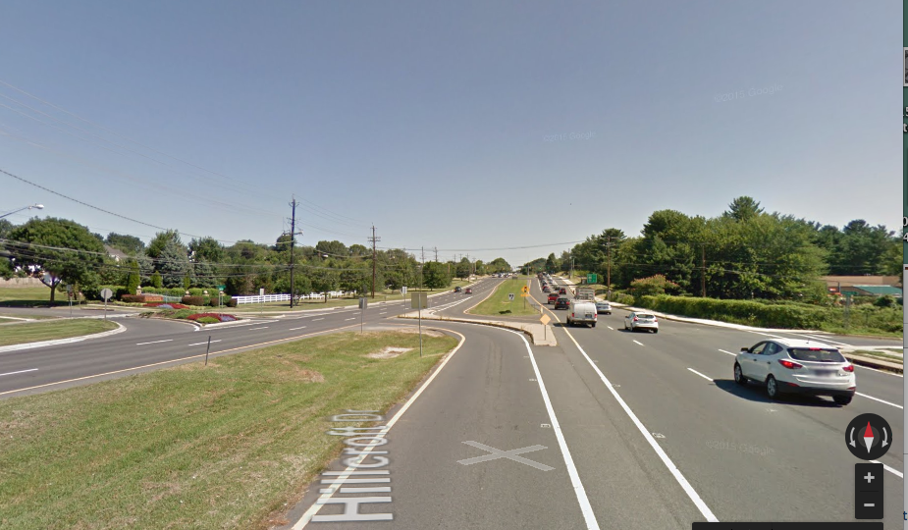
NB 97 & Hillcroft Rd

Slide 7
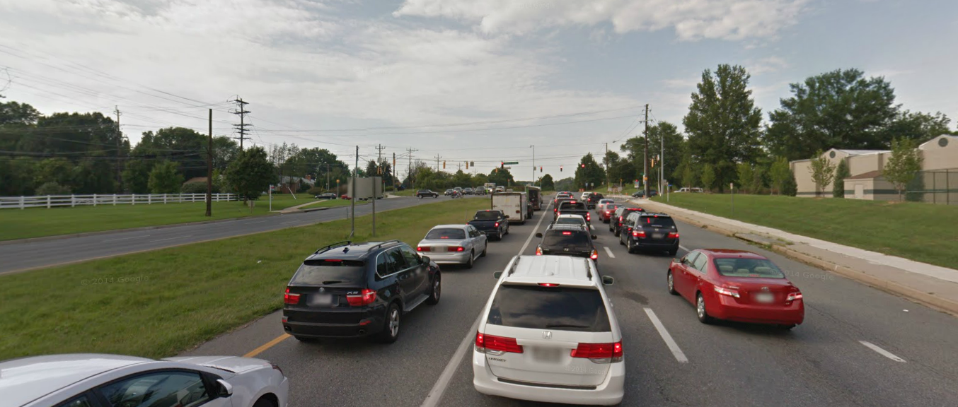
NB 97 & Emory Rd Turn Lane(s)
Extend lane from Emory pass Hillcroft. Add a second turn lane at Emory(Traffic backs up to ICC)

Slide 8
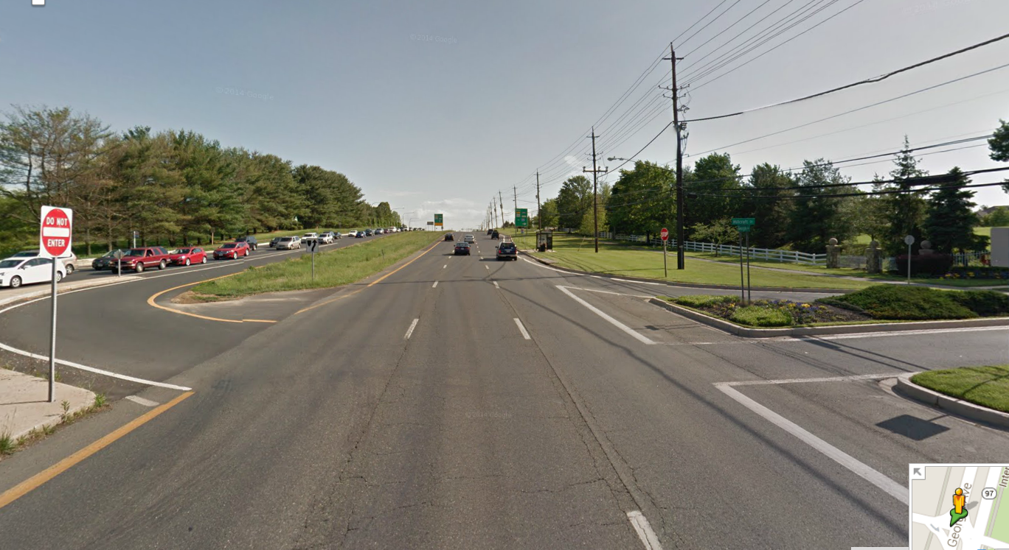
SB MD-97 & Hillcroft Rd
Extend Emory turn lane past Hillcroft to allow increased traffic flow on MD-97 & E-Emory La.
Note: Traffic cannot access Emory turn lane on N. MD-97 due to turn lane at Hillcroft into Brooke Manor (… traffic backs up from Emory to the ICC)
Eliminate Turn lane from MD-97 to Hillcroft Rd.
Add a lane from Emory to MD-200 (ICC) to relieve traffic flow in this area

Slide 9
Possible Solutions
Extend the NB97 left turn lane onto Emory Lane past Hillcroft Rd
Two left turn lanes from NB97 onto Emory Lane
Close entrance to Hillcroft from NB97

Slide 10
Connection between High St and Morningwood Dr

Slide 11
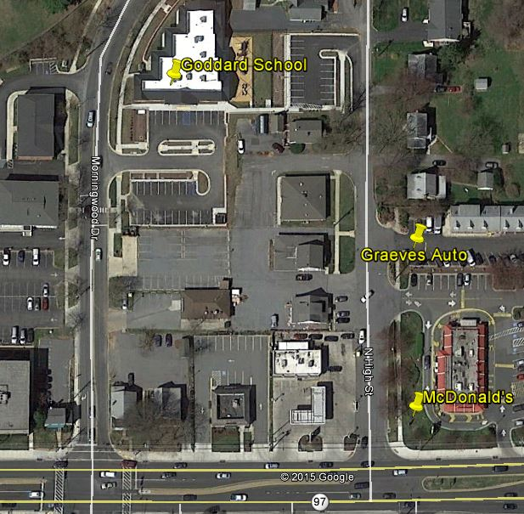

Slide 12
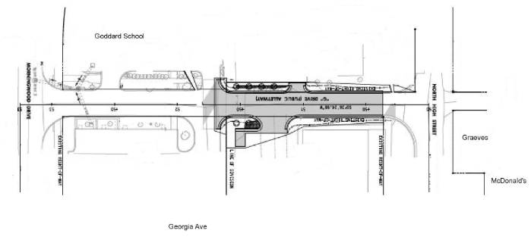

Slide 14
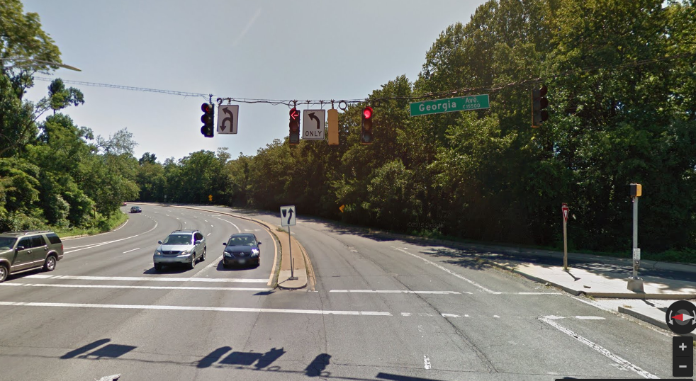
Route 28 east of Route 97

Slide 15
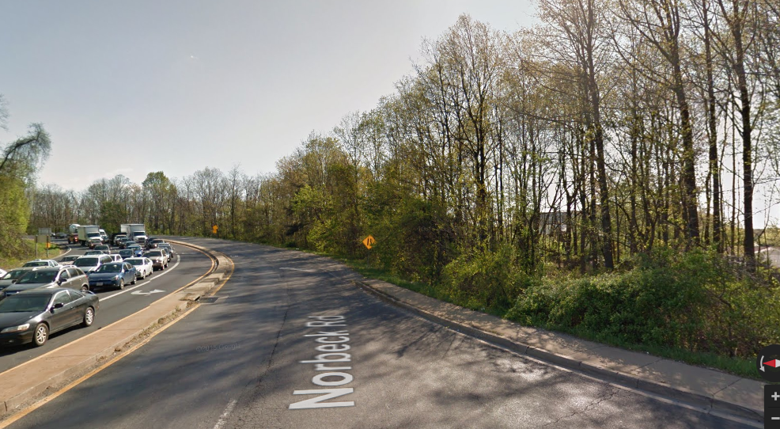

Slide 16
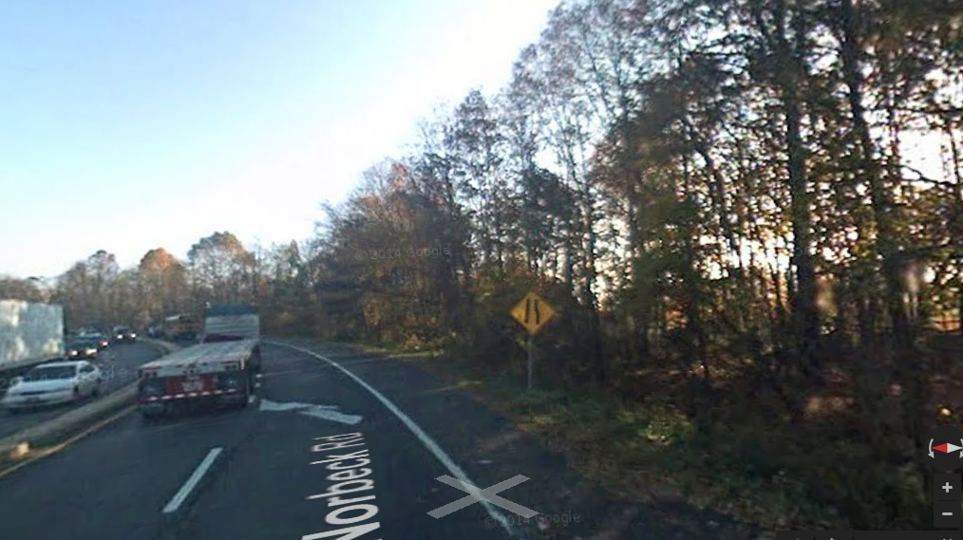

Slide 17
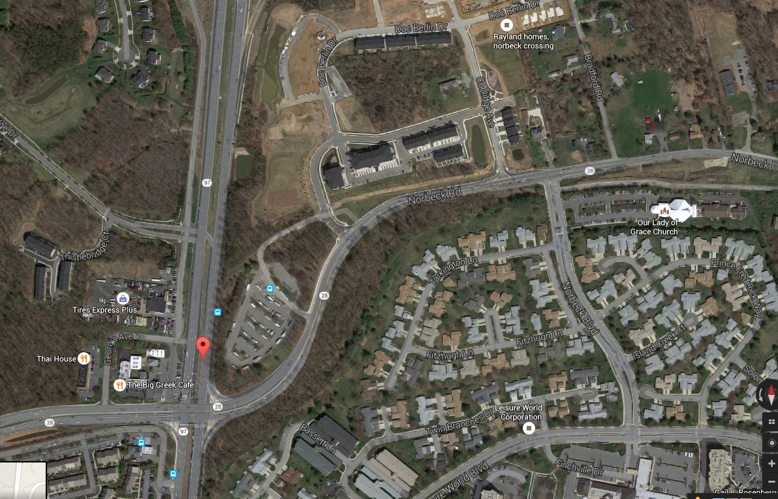

Slide 18
More Updates
Second left turn lane NB 97 onto WB 28 – fully funded for design & construction, expected to be completed by end of summer of 2017
SB97 right turn only into a through lane in front of Roots Shopping Center approved
Protected turns at several intersections along Route 108

Slide 19
Trails

Slide 20
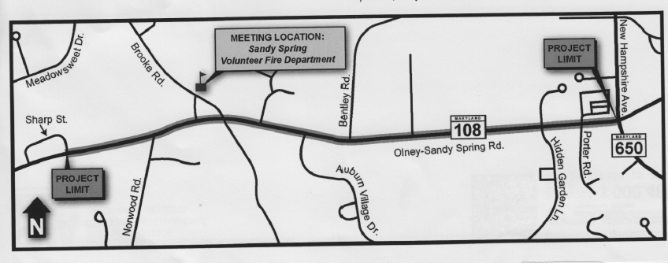
Proposed Multi-Use Trail along Route 108

Slide 21
Details
Install ADA compliant sidewalk on eastbound 108 and a shared use path along westbound side of 108 between 650 to Sharp St
Grinding and resurfacing existing roadway pavement
Signal improvements at Brooke Rd/108
Upgrading the mid-block crosswalk at Sherwood HS
Install landscaping

Slide 22
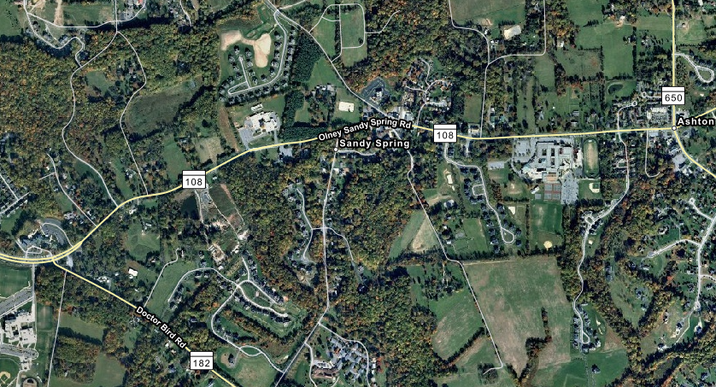

Slide 23
Proposed Resolution
Whereas Route 108 east of Dr Bird Rd is a narrow two lane road with no shoulders and high vehicle volume during am and pm peak hours
Whereas there are two public schools (Sherwood ES and Sherwood HS) along this section of Route 108
Whereas the current plan is to only build a trail from 650 to Brooke Rd leaving no connection to Sherwood ES
GOCA hereby resolves to support the 10 ft wide multi-use trail to be built the FULL length of the Project Limits (650 and Sharp St)
And
Requests the shared use path is extended west to Dr Bird Rd in order to provide safe routes to these two schools for students and for commuters from the Olney area.

Slide 24
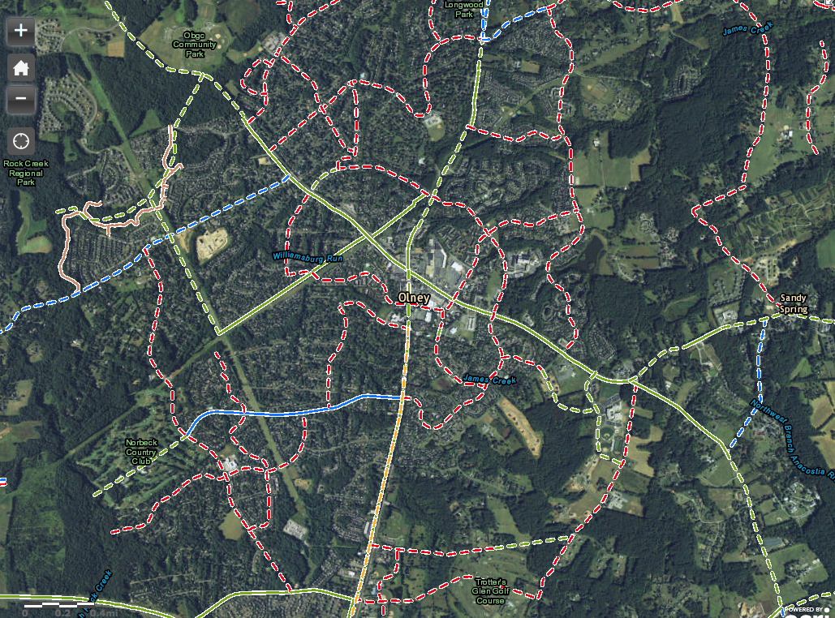
From: http://mcplanning.maps.arcgis.com/apps/OnePane/basicviewer/index.html?appid=f7dbf4591ca247f3acb949f907839d3e

Slide 25
Bowie Mill Rd Bikeway (separate presentation)

Slide 26
Transit

Slide 27
Transit related survey questions
Almost half (46%) would consider a point to point express shuttle to metro for some of their trips or for commuting to/from work
30% said would not use shuttle since destination not close to metro stop
Factors that would entice one to use a shuttle:
Cost is less than driving (56%)
Little wait time (48%)
Saves time (45%)
Guaranteed ride home (42%)
Notes:
24% would never use a shuttle even if the stop was in front of house

Slide 28
What might this mean?
Potentially 75% of Olney residents would consider a point to point express shuttle and cost, travel time, and guaranteed schedule are factors influencing their decision.
Working with private sedan company to explore this option

Slide 29
ITA (Independent Transit Authority)
County asked state for permission to create an ITA in order to build and fund mass transit (BRT)
Will be able to levy new taxes exceeding charter limits
The ITA operates separately from the current MCDOT
ITA reports to the County Executive
No Comparative “Alternative Analysis” has been done to justify Prioritization and Funding ($2.2Billion) for local BRT
Power of Eminent Domain = no protection for homeowners and businesses and no compensation formulas for fair pricing
Notes:
(up to $380 per/yr/resident/30 yrs, and more for businesses

Slide 30
ITA timeline
Transit Task Force held a forum on 9/30/2015 to receive feedback from the community. GOCA sent in written testimony reiterating March’s resolution
MoCo State Delegation will hold a public hearing on 11/30/2015

Slide 31
ITA will be fully discussed at the November 10, 2015 GOCA meeting

