Slide 1
Legislative District 14 Greater olney Civic Association Senator Zucker, Delegates Kaiser, Mireku-north, and Queen
Tuesday, June 11th, 2024
7:00 PM

Slide 2
Tonight’s Agenda
Introductions: Team and District
Team Focus: Constituent Service
Budget: District 14, Montgomery County, and the State
2024 MGA Priorities
Individual Team Member’s Legislative Highlights
Questions

Slide 3
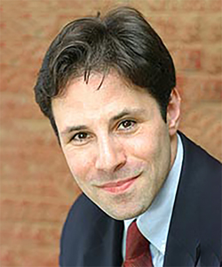
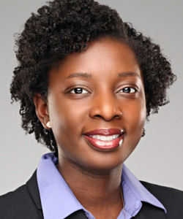
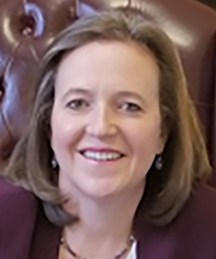
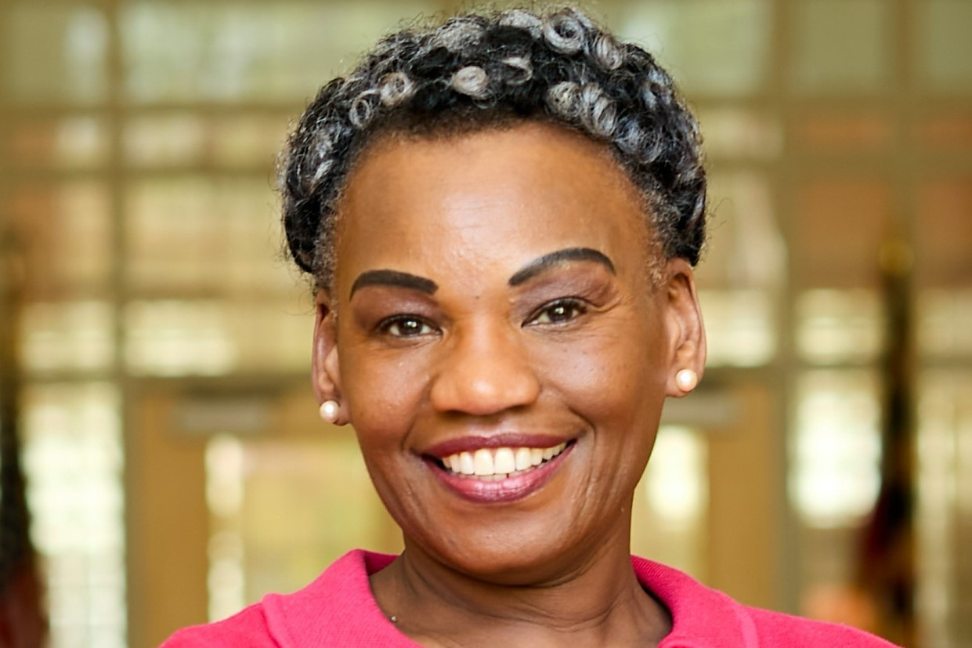
Your District 14 Team
Craig Zucker is the State Senate Democratic Caucus Chair, and chair of budget subcommittee for capital funding. He also serves on the subcommittee that reviews all health spending. He works as VP of a company when not in session. He lives with his wife, Jenny, and their sons Ben and Sam in Brookeville.
Bernice Mireku-North serves on the Ways and Means Committee and the Local Revenue and Early Childhood subcommittees. She manages her own law practice focused on criminal defense, guardianship, and some civil and business matters. She lives in the Fairland neighborhood of Silver Spring with her husband Terrill and daughter Adjoa Blessing, a Tyler Page Penguin.
Anne Kaiser serves on the Health and Government Operations Committee. She grew up in Montgomery County and graduated from MCPS. She is a full-time professor at the University of Maryland, College Park. She lives with her wife, Nancy, and their daughter Allison Joan “AJ” in the Calverton neighborhood of Silver Spring.
Pam Queen serves on the House Economic Matters Committee and chairs the Subcommittee on Banking, Consumer Protection, and Commercial Law. The Speaker selected her to co-chair the House Study Group to Study Economic Stability. Dr. Queen has a PhD in Finance and is a full Finance professor at Morgan State University. She lives in Olney.

Slide 4
Constituent Services
The team’s primary function is to serve our you. We can:
Assist with any interaction with Maryland government. (We have helped hundreds of constituents get their unemployment checks more timely.)
Connect you with the appropriate person in Montgomery County government.
Partner with our Federal government counterparts.
Our contact information is at the end of the presentation.
4

Slide 5
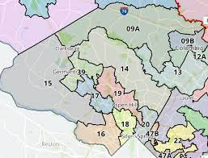
Communities in District 14
Communities: Ashton, Brinklow, Burtonsville, Calverton, Clarksburg, Cloverly, Colesville, Damascus, Etchison, Fairland, Goshen, Olney, Sandy Spring, Silver Spring, Spencerville and Sunshine
Municipalities: Brookeville and Laytonsville
Population: 128,000 (2020 census)
High Schools: Blake, Clarksburg, Damascus, Magruder, Paint Branch & Sherwood

Slide 6
BUDGET: DISTRICT 14 Capital Funding Greater OLNEY HIghLightS

Slide 7
Team Delivers: $10,000,000 Budget: funding in district 14 (part 1)
Community Project Construction ($2.2 million): Market Street in the Town of Brookeville (500K); Damascus Heritage Society Museum (75K); Solar-Resiliency Project at People’s Community Baptist Church (300K); Sandy Spring Slave Museum (40K); Friends House Retirement Community (200K); Olney Police Satellite Station (25K); Sandy Spring Civic Association (50K); Damascus Library (957K); and wayfinding signage for three breweries, distilleries, and wineries in the district (25K) and Oakdale Emory Church Public Market ($50K).
Community Development ($2 million): small business grants for the Burtonsville Crossing Shopping Center.

Slide 8
Budget: funding in district 14 (part 2)
Transportation ($280 thousand): Damascus Sidewalk Repair outside of Victory Haven Senior Apartments (30K) and Inter-County Connector Sound Barriers between Layhill Road and New Hampshire Avenue (250K).
Healthcare Facility Construction ($2.114 million): MedStar Montgomery County Medical Center- Emergency Department (1.1M); Children’s Hospital in the East County ($1M); and fix broken windows at Winter Growth (14K).
Parks, Recreation, and Land Preservation Construction ($3.3 million): Bowie Mill Road New Bike Trail (2.1M); Olney Boys and Girls Club - Performance Sports (250K); Fairland Recreational Park for a new skate park (500K); Sherwood High School Women's Softball field (330K); and Damascus High School stadium (100K).

Slide 9
Budget: Montgomery county
The District 14 Delegation helped secure more than $133 million for Montgomery County in additional capital funding and over $1.1 billion in direct state aid, including:
$43 million in additional transportation funding, including, $27 million for Bus Rapid Transit;
$980 million for K-12 education;
$3.7 million for libraries;
$75 million for community colleges;
$20 million for public safety;
$27 million BRT; and
$20 million for health facilities, including Children’s National Hospital, Holy Cross Hospital, MedStar Montgomery, and Shady Grove Hospital.

Slide 10
Budget: state priorities (A reflection of our values)
Added $330 million to fix our local roads and bridges;
Added nearly $500 million to enhance childcare;
Added nearly $50 million for police aid;
Included $90 million for climate pollution reduction efforts; and
Increased salaries for providers serving the developmentally disabled, behavioral health providers, nursing homes, and most Medicaid community-based providers.

Slide 11
2024 General Assembly Priorities
Francis Scott Key Bridge
Health Care
Education
Child Poverty & Strengthening Communities
Labor and Employment
Consumer Protection / Data Privacy

Slide 12
Francis scott key bridge
With the collapse of the Francis Scott Key Bridge on March 26th, the MGA quickly took actions to address the needs of families impacted by loss of loved ones and financial assistance for workers and businesses.
These actions included passage of the Maryland Protecting Opportunities and Regional Trade (PORT) Act which:
Provides scholarships for children and spouses of those who loss loved ones;
Offsets wages for port employees, independent contractors, and designated businesses; an
Provides resources to rebuild the Francis Scott Key Bridge.

Slide 13
Health CaRe
Maryland Maternal Health Act of 2024 ensures that Maryland codifies practices to protect new mothers and newborns. Hospitals must provide new parents with the resources and information they need postpartum but also reach out to parents after discharge from the hospital.
Breast and Lung Cancer Screening – Coverage Requirements provides health equity by extending coverage for follow-up diagnostic tests after initial screening for breast cancer and lung cancer detect the need for further testing.
Advanced Practice Registered Nurses expedites the paths for nursing students to be certified as advanced practice registered nurses and begin their clinical rotations while enrolled in accredited graduate programs.
Behavioral Health Crisis Response Services – 9-8-8 Trust Fund Fees establishes a permanent funding source for 988, the Suicide and Crisis Helpline. 988 is a vital lifeline and resource for mental health support that is available 24/7 for those experiencing mental health crises.

Slide 14
Education
Freedom to Read Act establishes a set of state standards for school and public libraries to ensure that libraries cannot exclude materials due to origin, background, or views of the author.
Student Telehealth Appointments-Policy and Access requires each county board of education to establish a policy to accommodate students who need such appointments during the school day.
The Secured Schools Emergency Response Grant Program gives grants to local schools to improve emergency notification systems and communications between public elementary and secondary school personnel, public safety answering point and public safety agency.
School Employee Antibias Training-Requirements law establishes an anti-bias teacher training program focused on combating biases, prejudices and discrimination faced by historically marginalized minorities.

Slide 15
Child Poverty & Strengthening Communities
The “Engaging Neighborhoods, Organizations, Unions, Governments, and Households” (known as the ENOUGH) Grant Program will combat concentrated poverty by increasing community health and safety; connecting our neighbors in need to jobs; improving child care and education; boosting access to health care and quality support for children with disabilities, child welfare and justice involved youth and young adults; connecting persons to state program; and leveraging other funding sources.
Property Tax- Renters’ Property Tax Relief Program-Assets Calculation no longer considers retirement savings plans and individual retirement accounts when determining renter’s property tax credits.
Housing Expansion and Affordability Act of 2024 will improve affordability by allowing new housing where we need it most: transit-oriented development, formally government-owned campuses, and charity owned property ( including property of houses of worship) .

Slide 16
Labor and Employment
Time to Serve Act 2024 protects state employees from using personal leave to meet requirements for National Guard, military reserve, or disaster service. Allows up to 30 days of approved leave.
Catastrophic Event Account & Federal Government Shutdown Employee Assistance Loan Fund extends eligibility for certain Maryland employees to receive financial assistance under the Federal Paycheck Protection Act during federal government shutdowns.
Several laws address shortages in the healthcare workforce with modifications to licensure and reciprocity requirements.
Equal Pay for Equal Work endeavors to close the gender wage gap by requiring employers to post salary range for job listings.

Slide 17
Consumer Protection / Data Privacy
Maryland On-line Data Privacy Act of 2024 protects consumers by limiting what data can be collected and sold to other parties. Consumers are provided opt-out provisions.
Maryland Kids Code requires tech companies to design online products with consideration of kid’s privacy, safety, and wellness. Limits selling of kids’ information.
Platforms for sales and resale of concert and sports tickets must disclose upfront total costs and fees. Also, requires the Office of Attorney General to study ways to prevent ticket scalping.
Updates made to the Electricity and Gas retail supply regulations to protect consumers from predatory third-party retail energy suppliers.

Slide 18
Our individual victories
Pam: Wage Transparency; Online Gambling Prohibition – Higher Education
Craig: Bus Rapid Transit Funding; Division of Rehabilitative Services Funding
Anne: Green Death Care Act; promotion of Earned Income Tax Credit
Bernice: Termination of Residential Lease-Limited of Liability of Rent; Loan Assistance Repayment for Public School Nurses

Slide 19
Contact Us Anytime
Senator Craig Zucker
301-858-3625
craig.zucker@senate.state.md.us
Delegate Anne Kaiser
301-858-3036
anne.kaiser@house.state.md.us
Delegate Bernice Mireku-North
301-858-3539
Bernice.mireku-north@house.state.md.us
Delegate Pam Queen
301-858-3380
pam.queen@house.state.md.us
MD General Assembly Website:
http://mgaleg.maryland.gov/mgawebsite

Slide 20
questions

