Slide 1

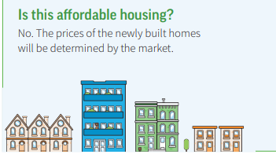

Slide 2
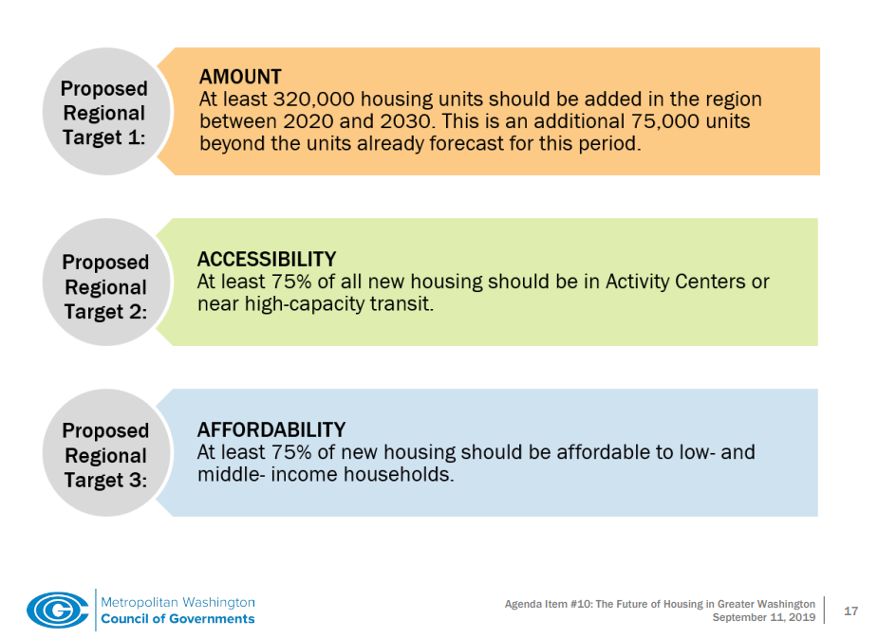
75% of new housing should be affordable

Slide 3

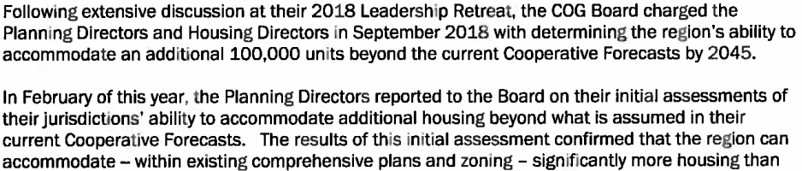

Slide 4


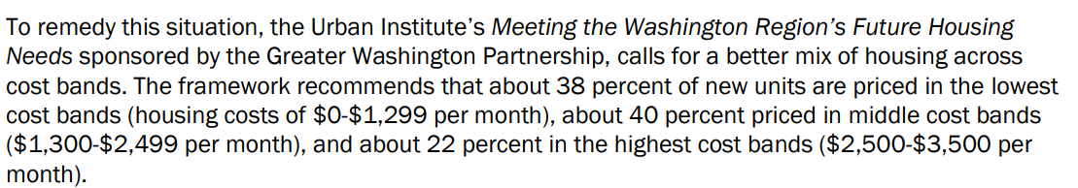
What does that translate to annual income?
38%: Lowest cost bands (housing costs of $0 - $1,299 per month)
Annual income of $0 to $51,860
40%: Middle cost bands ($1,300-$2,499 per month)
Annual income of $52,000 to $99,960

Slide 5
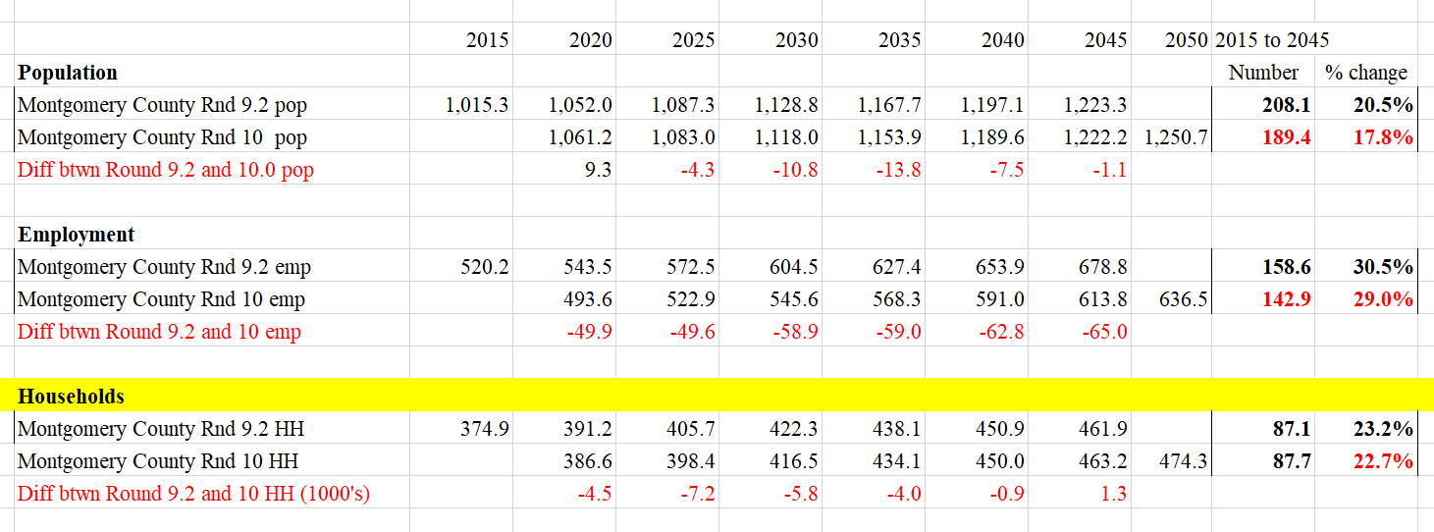

Slide 6
